Slide 1
Start the program by:
click on Slide Show at the top
Click on From Beginning at the upper left
Program will start after 10 seconds
Click on Esc on the keyboard to stop
*Find us on Facebook at https://www.facebook.com/stjohnslutherancullom/

Slide 2
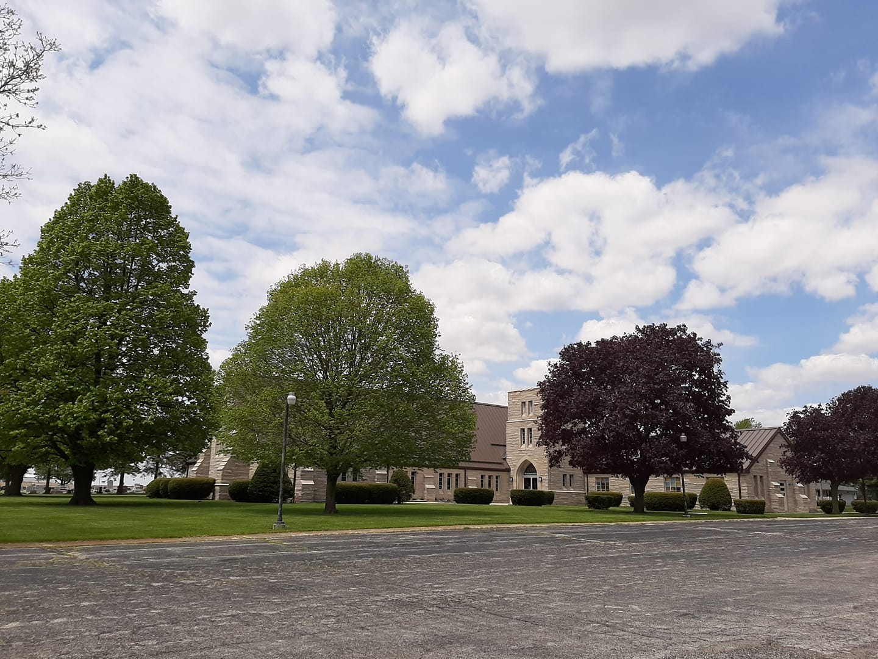
Welcome to St. John’s Evangelical Lutheran Church in Cullom, Illinois.

Slide 3
The village of Cullom, population 550, is a farm community in east-central Illinois. It sits amid relatively flat farmland, some of the most fertile and productive in the world.

Slide 4
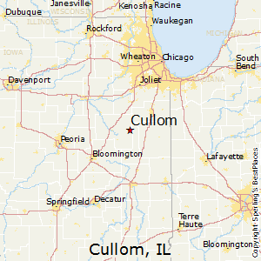
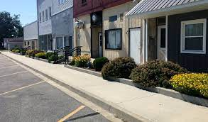
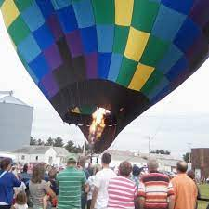
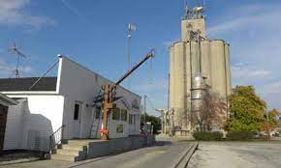
Cullom’s main street (Hack Street) is one block long. It has a community owned grocery store, antique shop, beauty parlor, 2 insurance agencies, an accountant, an attorney, 2 museums, a tavern, a surveyor, a bank, a doctor’s office, a library, and the Post Office. On the east end is a lumber yard and the local grain elevator. On the west end is Casey’s General Store.

Slide 5
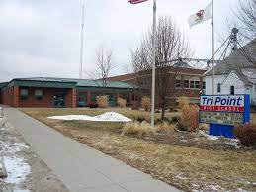
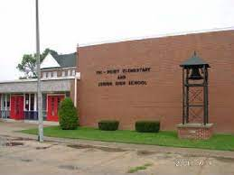
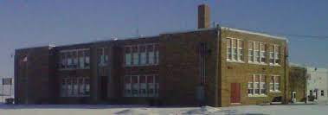
Children in Cullom attend the Tri-Point School District which includes the villages of Cullom, Kempton, Cabery, and Piper City; all elementary students attend in Piper City, all high school students attend in Cullom. Incidentally, our good partners in Christ’s ministry, the Cullom United Methodist Church, are located here on the front yard of the high school.

Slide 6
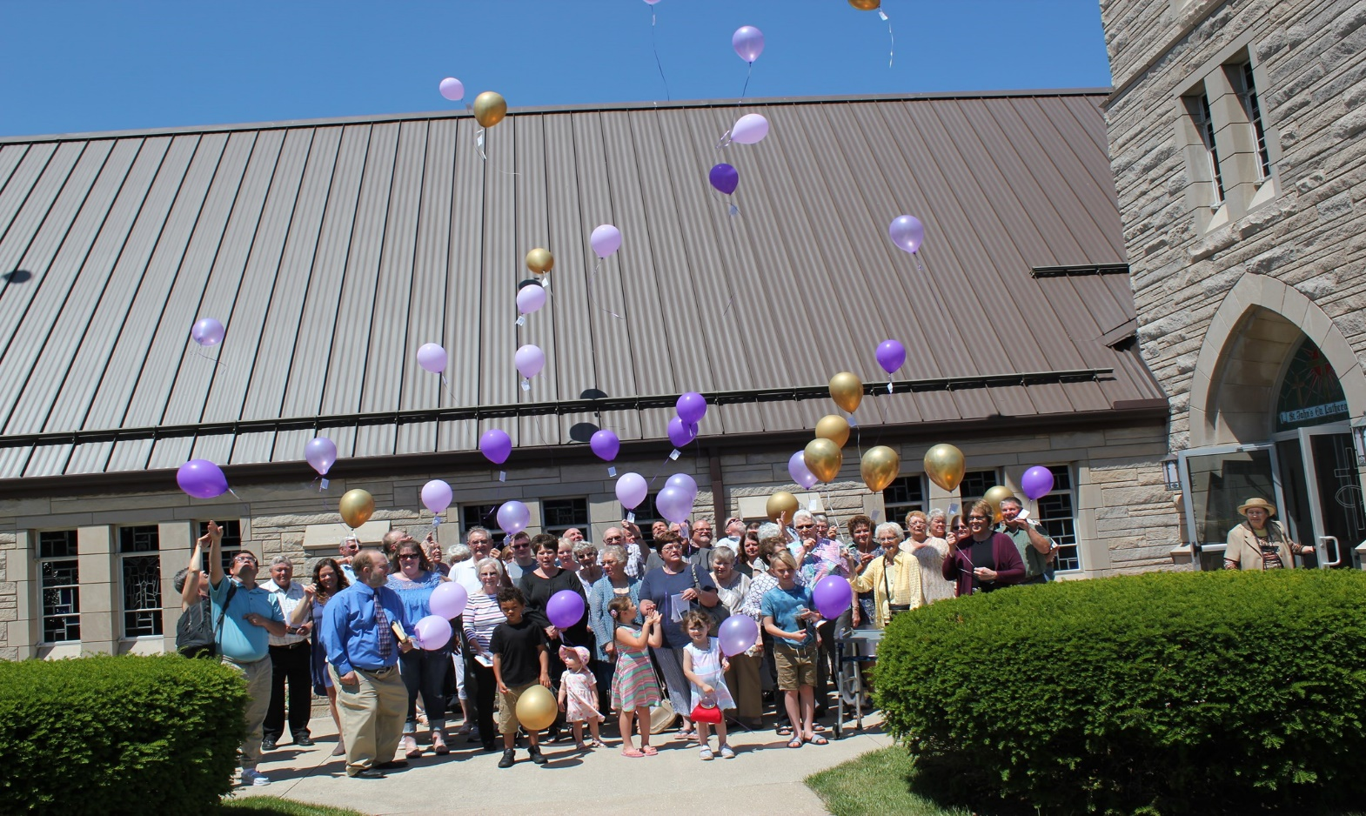
St John’s Lutheran Church was founded 150 years ago in 1871. The current building was constructed in 1961 and is 100% handicap accessible, no steps to enter and no steps in the church. This allows for full usage of the building by our congregation and usage by numerous community events and organizations. In addition, a parsonage was built with 3 bedrooms, a large kitchen/dining room, large office, 2 car garage, and a full basement.

Slide 7
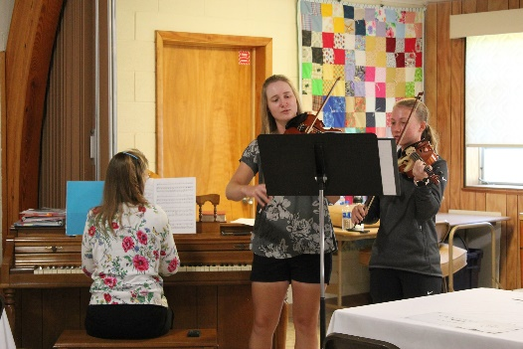
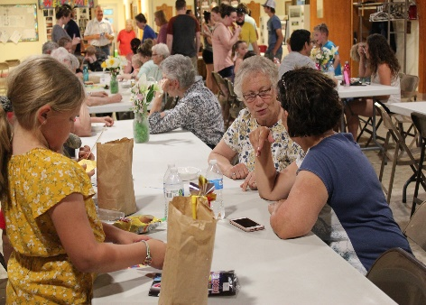
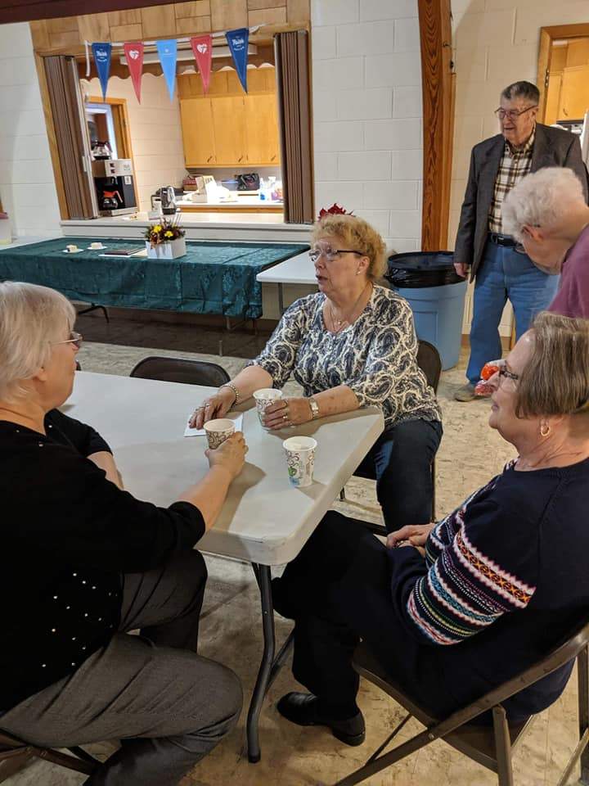
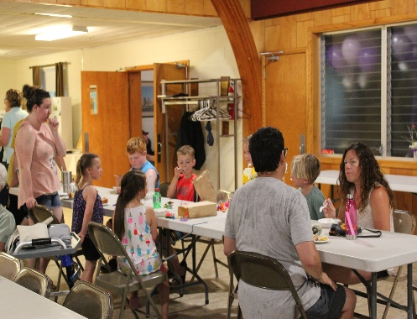
l
Our church has 8 classrooms and storage rooms, a church secretary’s office, full kitchen, handicap accessible restrooms, parish hall with seating for 150, choir room, pastor’s study, and worship area (nave) with seating for 240. The building is fully heated and air-conditioned and has been well maintained throughout the years.

Slide 8
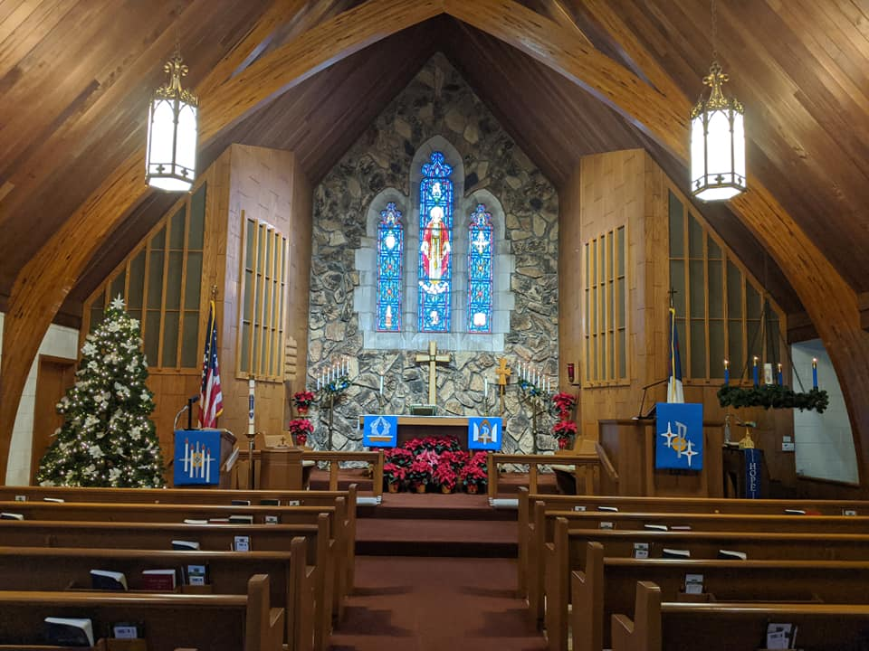
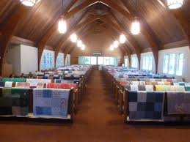
St. John’s Evangelical Lutheran Church congregation draws mainly from the Cullom, Kempton, and Saunemin communities, although members are scattered throughout the area as some members regularly travel 30-40 miles to attend Saturday evening and/or Sunday morning worship services. We also have members across the United States, especially our faithful snowbirds. We live-stream our services on Sundays and our text study on Thursdays. We offer Sunday school for all ages.

Slide 9
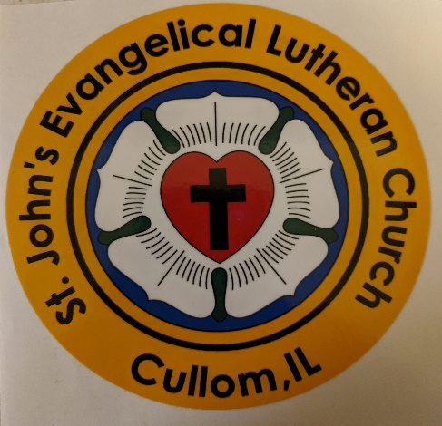
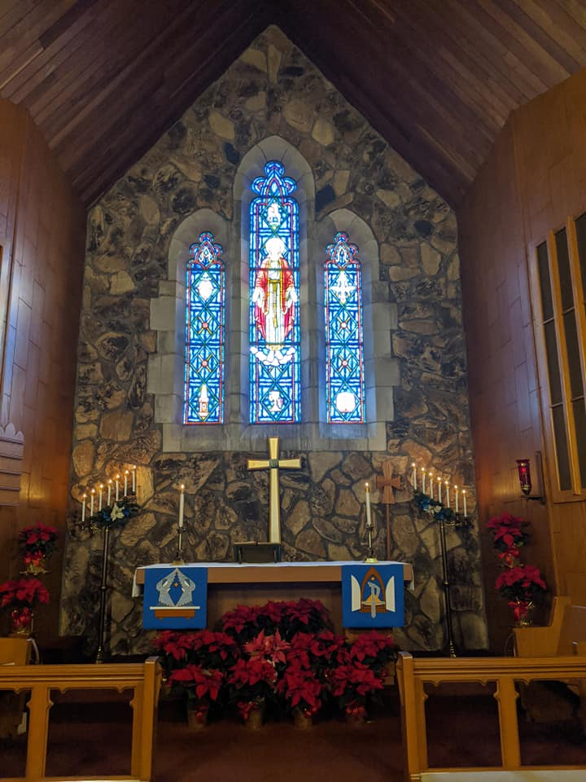
As a member of the North American Lutheran Church, we are Christ centered, mission driven, traditionally grounded, and congregationally focused. We have remained faithful to our cherished Lutheran values and beliefs in faith, hope, love, and forgiveness through the grace of God while facing the challenges of today’s society and world. We invite you to take a drive out here to God’s Country and visit our church and its people.
.
St. Johns Evangelical Lutheran Church
Cullom, Illinois
We are a church to believe in!

